Slide 1

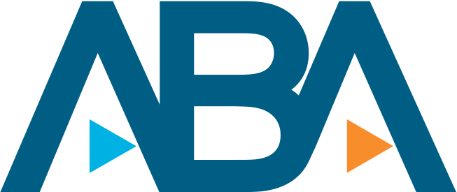
Datafest 2023:
ABA Challenge
Team JAVA
Jakob Danninger, Ashley Sah, Kiet Nguyen, Zhuldyz Ualikhankyzy, Vibha Mandayam

Slide 2
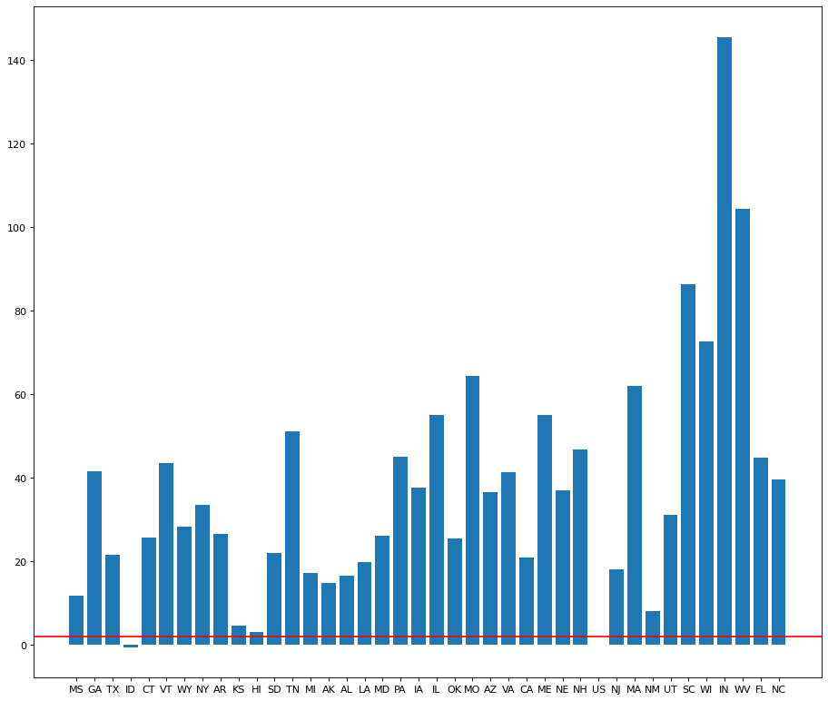
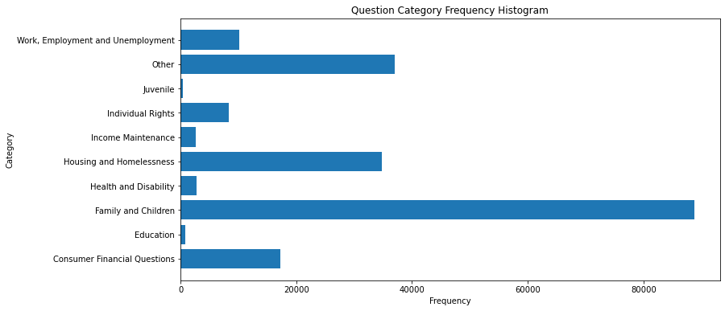
Customer Portrait
In 38 out of 42 regions/states, the proportion of non-white clients is significantly higher than the state’s non-white population proportion.
Used US Census data from 2020
Compared the proportions of white people in both populations using a one-sided z-test
The histogram to the right depicts what question categories appear to be most significant for the clients.

Slide 3
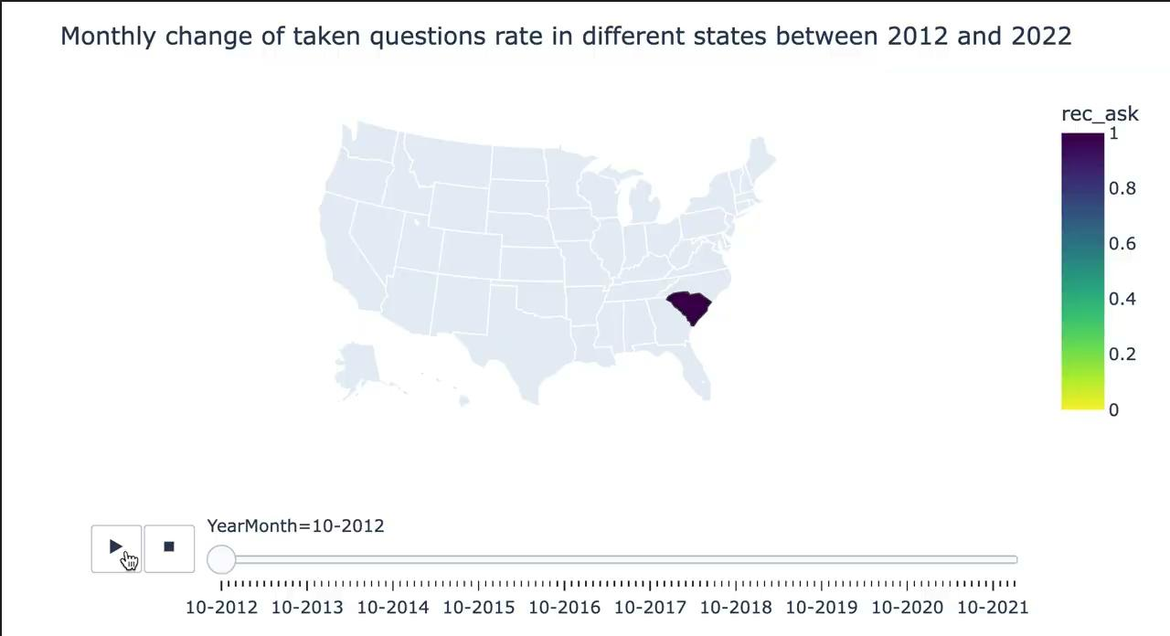
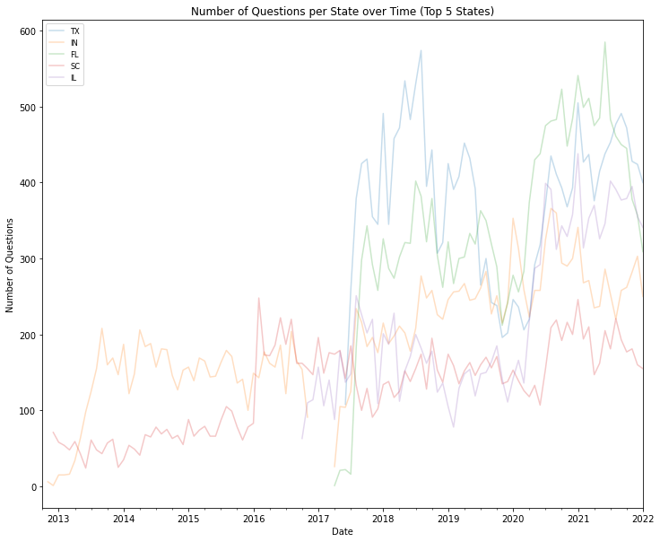
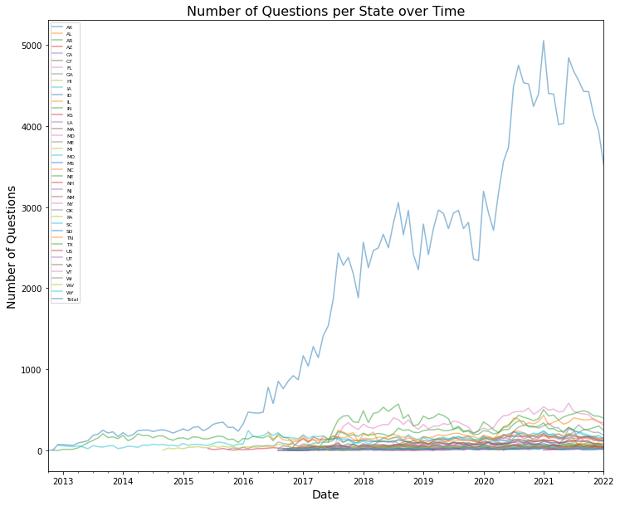
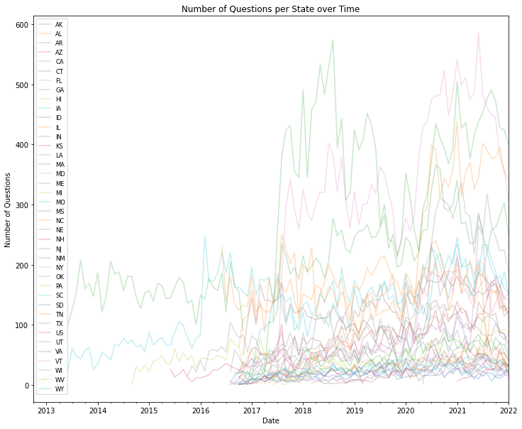
Questions Traffic
Over time we can see the increase in response rate across all states, however this positive trend worsens after 2020, where the service becomes more popular, but attorneys cannot take all the input questions
The top 5 largest question generators states include two states that fall into the category of the least white category, which confirmed the hypothesis that was presented earlier.

Slide 4
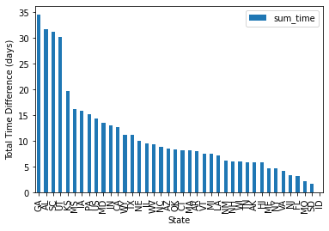
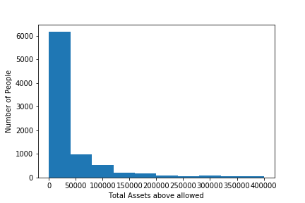
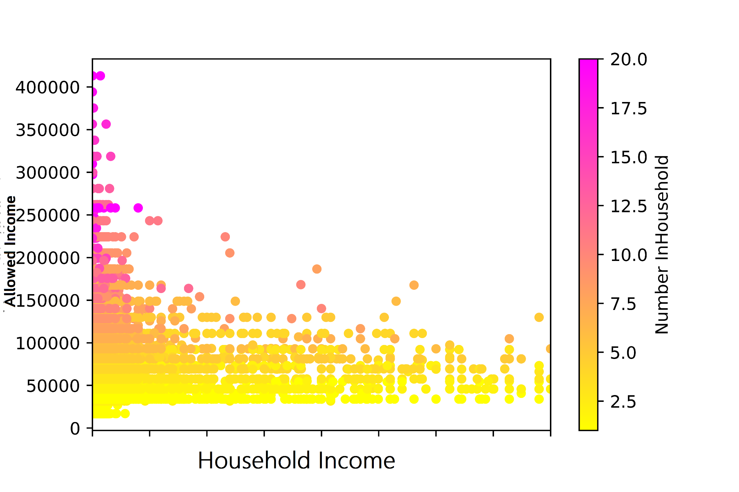
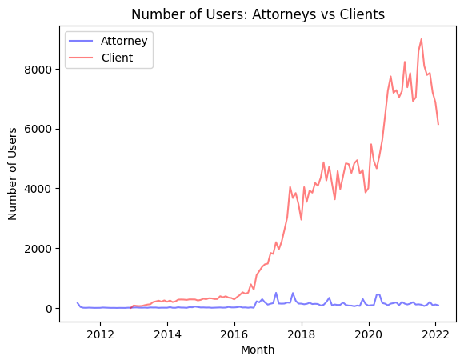
Trends and Suggestions
The histogram shows the distribution of states by time taken for question to be considered..
The histogram shows the distribution of clients with more assets than allowed
As seen above, there appears to be a spike in new client users around the pandemic (2020-2021). The number of new attorney users does not appear to match that spike. It also appears that after 2022, the number of attorneys has decreased, perhaps due to resumption of regular working hours. Hence, new incentives for attorneys should be introduced.
Generally people with a high household size tend to be lower income and should be prioritized in outreach efforts

